Slide 1

Covid-19 Analysis
Dashboard

Slide 2
PROJECT REPORT
1. Title Page
Title: COVID-19 Global Data Analysis using Power BI
Subtitle: A report on worldwide COVID-19 cases and deaths based on Worldometer dataset
Prepared by: [Palak , Tinku, Tanvi, Kritika]
Date: [26 Aug, 2025]
2. Abstract
This project focuses on analyzing the global spread and impact of the COVID-19 pandemic using data from Worldometer. Using Power BI, the dataset was cleaned, transformed, and visualized to create an interactive dashboard that highlights trends, country-level and continent-level analysis, and a global overview of cases and deaths.

Slide 3
3. Problem Statement
COVID-19 has significantly impacted public health, economies, and societies worldwide. The primary goal of this project is to analyze COVID-19 data to identify:
The most affected countries and continents.
Trends of cases and deaths over time.
Comparative analysis of the pandemic’s spread across different regions.

Slide 4
4. Data Source & Preparation
Data Source: Worldometer Coronavirus Statistics (worldometers.info/coronavirus)
Dataset Fields Used:
Total Cases, Active Cases, Total Deaths, Total Recovered
Country/Continent
Daily Case Updates
Data Preparation Steps:
Imported dataset into Power BI
Cleaned and formatted data (handled missing values, corrected data types, removed unnecessary columns)
Created calculated measures such as:
Mortality Rate = Total Deaths / Total Cases
Recovery Rate = Total Recovered / Total Cases
Active Cases = Total Cases – (Total Deaths + Total Recovered)

Slide 5
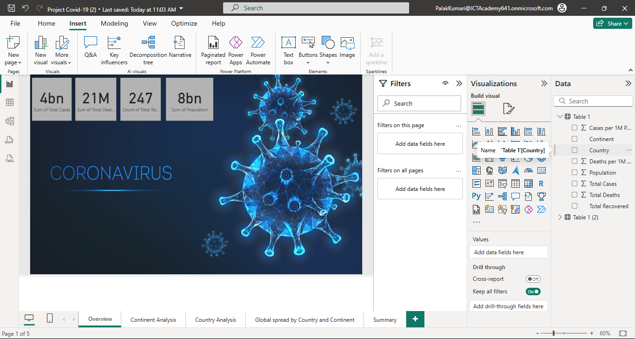
5. Report Pages & Visualizations
🔹 Overview Page
KPIs: Total Cases, Deaths, Recoveries, Mortality Rate
Card: Country and Continent-wise total population, deaths, cases and total recovered

Slide 6
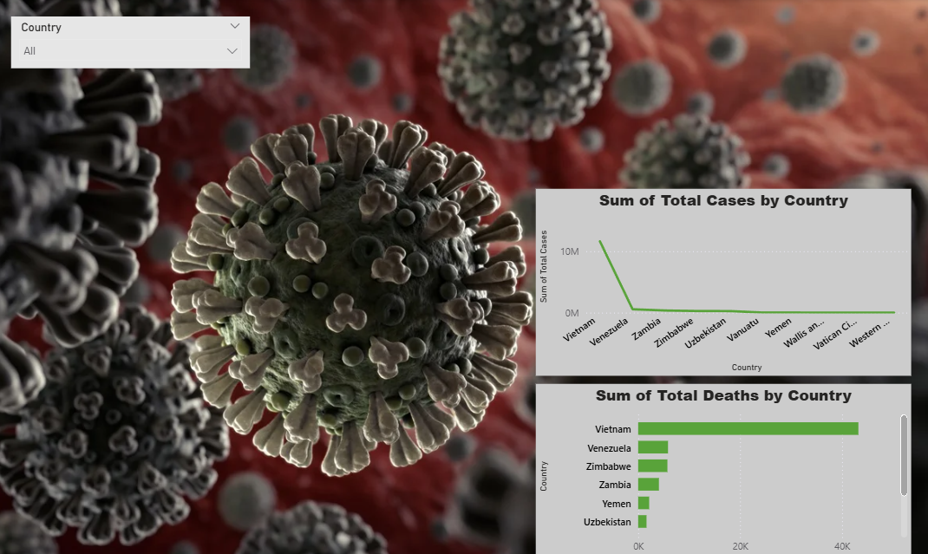
🔹 Country Analysis Page
Slicer: Country slicer
Stacked bar chart: Trend of daily deaths for a selected country
Line Chart: Trend of daily cases for a selected country

Slide 7
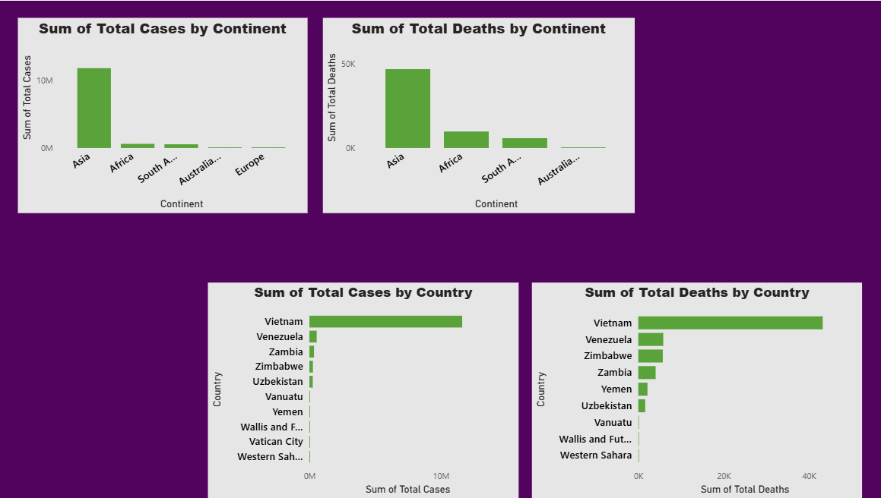
🔹 Continent Analysis Page
Column Chart: Cases & deaths per continent
Clustered bar chart: Country-wise total cases and deaths

Slide 8
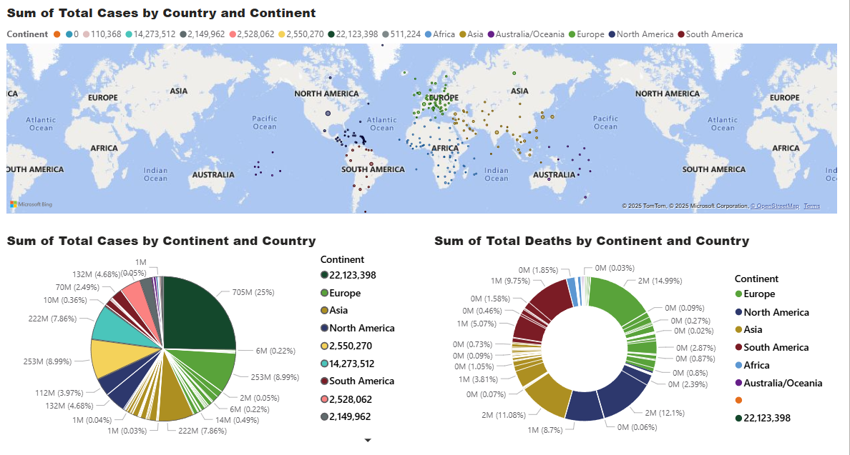
🔹 Global Spread (By Country & Continent) Page
Map Visualization: Bubble size = cases, color intensity = deaths
Pie Chart: Conditional formatting for highest-affected countries and continents with sum of total cases
Donut Chart: Conditional formatting for highest-affected countries and continents with sum of total deaths

Slide 9
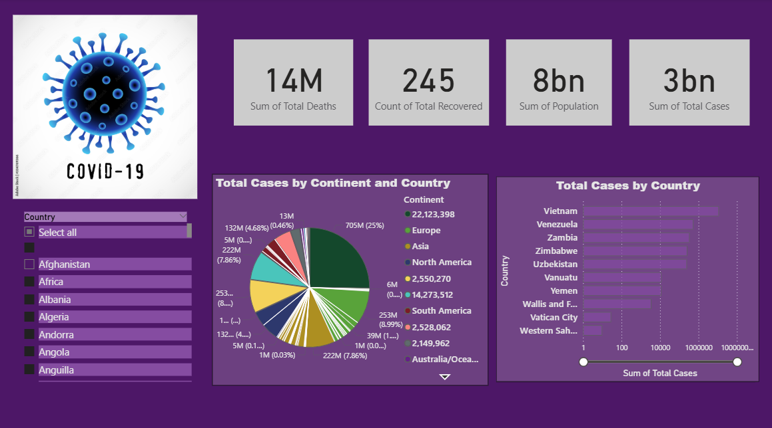
🔹 Summary / Insights Page
Key findings (written text + visuals):
Most affected continents/countries
Highest peaks of cases
Mortality & recovery trends
Notable anomalies (e.g., countries with high cases but low death rates)

Slide 10
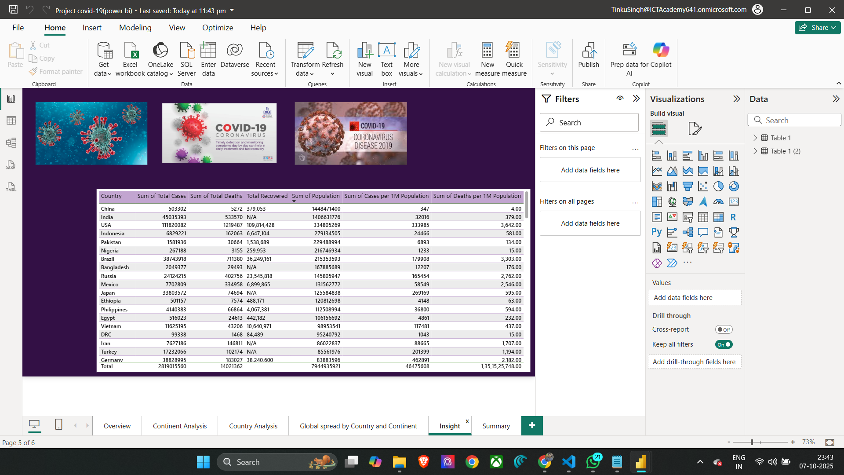
6. Insights & Findings
The Americas and Asia reported the highest cumulative cases.
Mortality rate was higher in early 2020 but declined after mass vaccinations.
USA, India, and Brazil remained the top three countries in terms of total cases.
Africa showed fewer cases overall, but underreporting may have influenced results.

Slide 11
7. Conclusion
The COVID-19 data analysis dashboard provides an interactive way to understand the spread and impact of the pandemic globally. The report identifies regional differences, highlights critical hotspots, and shows how recovery improved over time.

Slide 12
8. Future Scope
Adding vaccination data for correlation with declining mortality.
Including testing rates per country to understand reporting accuracy.
Forecasting future trends with machine learning models.

Slide 13
9. References
Worldometer COVID-19 Dataset: https://www.worldometers.info/coronavirus/
Power BI Documentation: https://powerbi.microsoft.com/

Slide 14
THANKYOU

